Slide 1
AI AGENT FOR NAAC ACCREDITATION
CAPSTONE PROJECT
Presented By:
Student name : Shaik Afshiya Sulthana
College Name & Department : Madanapalle Institute of Technology and Science, Computer Science & Engineering

Slide 2
OUTLINE
Problem Statement
Proposed Solution
IBM Cloud Sevices used
Wow Factors
End users
Algorithm & Deployment
Result
Conclusion
Future Scope
GitHub link

Slide 3
PROBLEM STATEMENT
NAAC (National Assessment and Accreditation Council) accreditation requires institutions to submit detailed documentation like the SSR (Self Study Report), best practices, and criteria-based evidence.
Preparing this data manually is time-consuming and error-prone. Faculty often struggle with formatting, aligning with current guidelines, and retrieving previous reports. There is a need for an AI agent that simplifies, standardizes, and accelerates this process.

Slide 4
Proposed Solution
The proposed system is an AI-powered assistant that uses IBM Granite and Retrieval-Augmented Generation (RAG) to support NAAC documentation.
The system helps faculty:
Retrieve NAAC criteria and documentation formats
Draft content for SSR criteria
Generate best practices examples
Answer queries like “What is required in Criterion 3?”
Improve documentation consistency and reduce manual effort

Slide 5
IBM CLOUD SERVICES USED
1.IBM Granite Large Language Models
2. IBM Cloud Lite
3. IBM Watson NLP
4. IBM Retrieval-Augmented Generation (RAG)
5. IBM Cloud Object Storage
6. IBM Cloud App Runtime / Hosting Environment

Slide 6
WOW FACTORS
Solves a real academic pain point – Automates NAAC documentation
Uses RAG + IBM Granite – Modern, enterprise-grade AI
Natural language interaction – Easy for faculty to use
Custom responses – Tailored for criteria, department, and institution
Scalable design – Can extend to NBA, AQAR, IQAC tasks
High practical value – Useful for real colleges, not just a demo

Slide 7
END USERS
1.IQAC Coordinators
2.Accreditation Committee Members
3.Faculty Members preparing SSR
4.Department Heads (HoDs)
5.NAAC Coordinators
6.Principal / Academic Deans
7.Administrative Staff involved in documentation

Slide 8
Algorithm & Deployment
Flow Steps:
1. User asks a question (e.g., “Give best practices for teaching-learning”)
2. IBM Granite interprets the query using NLP
3. RAG retrieves relevant content from stored NAAC documents
4. AI returns a structured and formatted response
Deployment:
Hosted on IBM Cloud Lite
Front-end built using Streamlit (web-based interface)

Slide 9
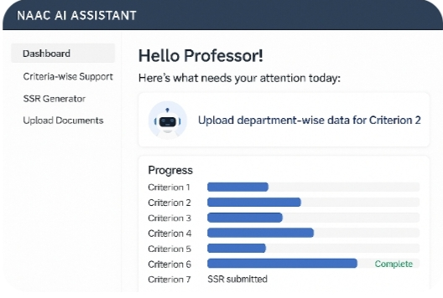
RESULTS

Slide 10
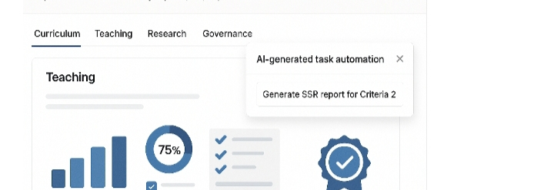
RESULTS

Slide 11
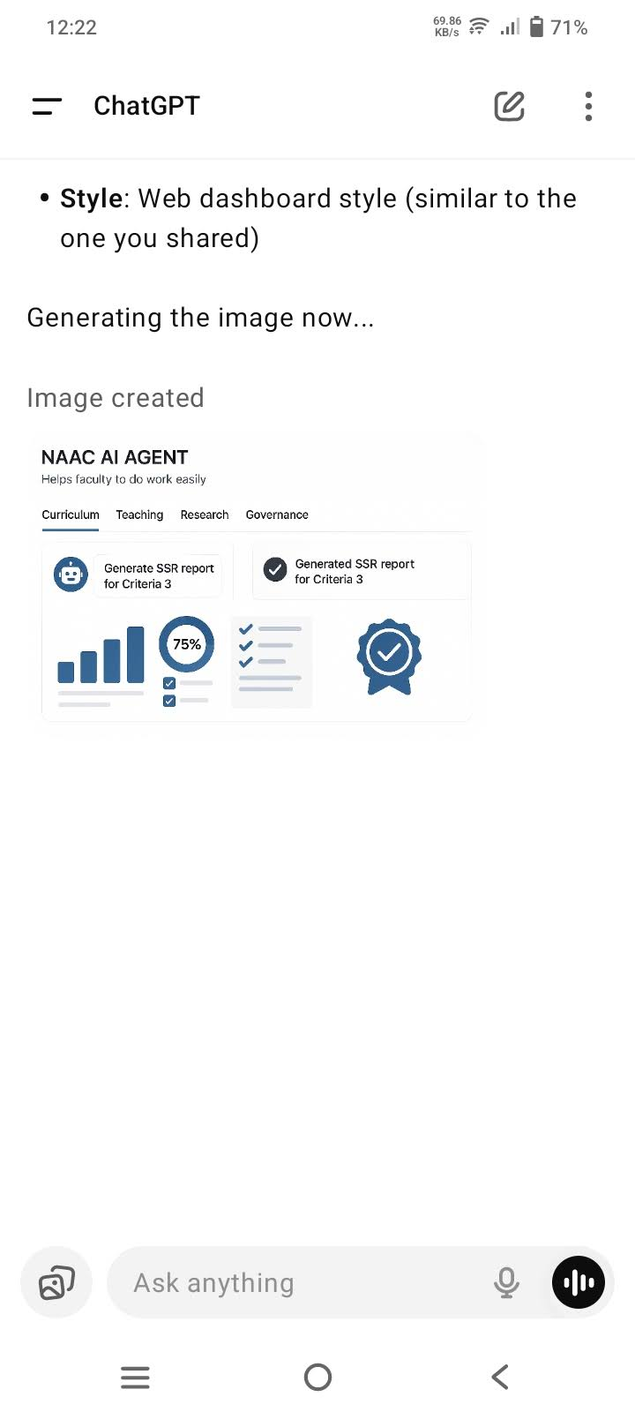
RESULTS

Slide 12
CONCLUSION
The NAAC Accreditation Agent successfully simplifies and accelerates the complex process of preparing accreditation documents.
By leveraging IBM Granite and Retrieval-Augmented Generation (RAG), the system generates accurate, criteria-specific content in natural language.
This AI assistant reduces manual effort, enhances documentation quality, and empowers faculty with real-time support for NAAC compliance.

Slide 13
FUTURE SCOPE
1.AQAR & NBA Support
2.Voice-Based Interaction
3.Multilingual Support
4.Department-Specific Template
5.Auto-Fill from Internal Data Sources

Slide 14
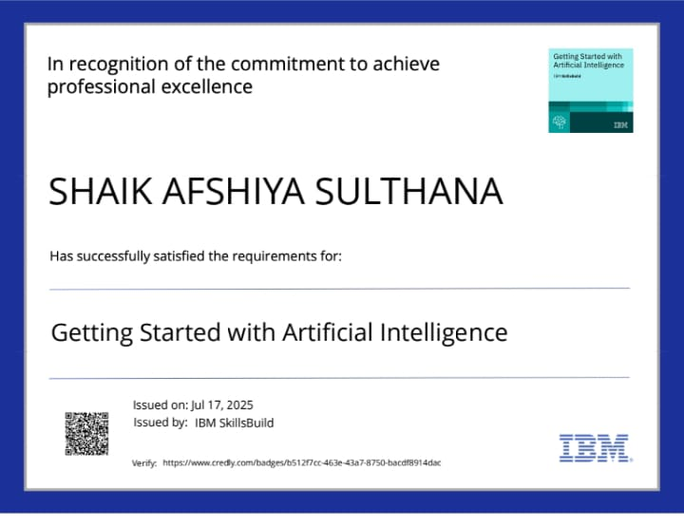
IBM CERTIFICATIONS

Slide 15
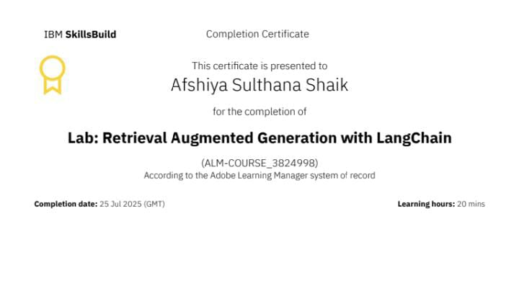

Slide 16
Git hub lik : https://github.com/AfshiyaSulthana08

Slide 17
GITHUB LINK
Make sure that there should be readme file

Slide 18
THANK YOU

